Slide 1

ELL887 Project
Food Dishes Catalogue Web Application
Team Members: Ritika Soni (2020MT10838) Sai Niketh Varanasi (2020MT60895)
Date : 10 May, 2024

Slide 2
Problem Statement
Current food-related data online is chaotic and disorganized.
Disorganization makes it hard for users to find needed information.
Our database offers a structured, user-friendly interface to solve this issue.

Slide 3




Outline of Our Idea
User Portal: Access point for food details.
User Functionalities: Filter and add food items.
User-generated Content: Contributions verified by admin.
Admin Portal: Admin approval adds items to database.

Slide 4
Enhancing Food Data Accessibility
Discover Dishes: Explore origins, types, and recipes.
Interactive Portal: Filter, and favorite dishes.
Community Contributions: Share your dish knowledge.
Admin-Reviewed: Ensuring accurate, reliable content.

Slide 5
Application Framework Overview
Interactive User Interface: Utilizes HTML, CSS, React.js.
Robust Back-end: Powered by Golang.
Structured Data Storage: Managed with SQL.
Efficient Collaboration: Supported by Postman and Git.

Slide 6
Initial architecture concept
User frontend
Admin
frontend
submits
information
entry rejected or approved by admin
If approved it goes to the user database
Datatable
of user
Datatable
of admin
Microservice - 1
Microservice - 2

Slide 7
Modified Architecture
To eliminate data dependencies among microservices, we implemented a modification in our data storage approach. This involved introducing an additional column labeled "Status," which indicates the status of each food item entry.
When a user submits data, it's recorded in the database with a status of "Not_Approved." Upon validation and approval by the Admin, the status is updated to "Approved." Conversely, if the Admin rejects the data entry, the status is changed to "Rejected."
This setup allows the user portal to display dishes with an "Approved" status, while the admin portal showcases those with a "Not_Approved" status, indicating pending action.

Slide 8
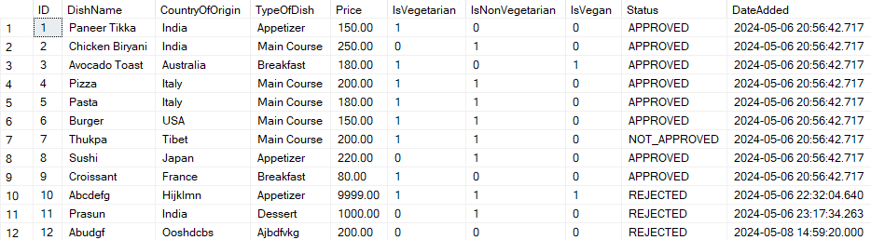
Table for Dishes

Slide 9
Architecture of WebApp
We've structured our system with separate User and Admin Portals to leverage the advantages of microservice architecture.
This approach enables us to develop and update each portal independently, enhancing flexibility and minimizing disruptions.
With this setup, modifications to the Admin Portal won't impact the User Portal, ensuring robustness and allowing for more frequent updates without affecting user experience.
This decoupling of services promotes scalability, maintainability, and overall system resilience.

Slide 10
Working of our App

Slide 11
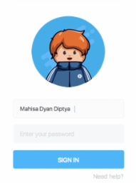



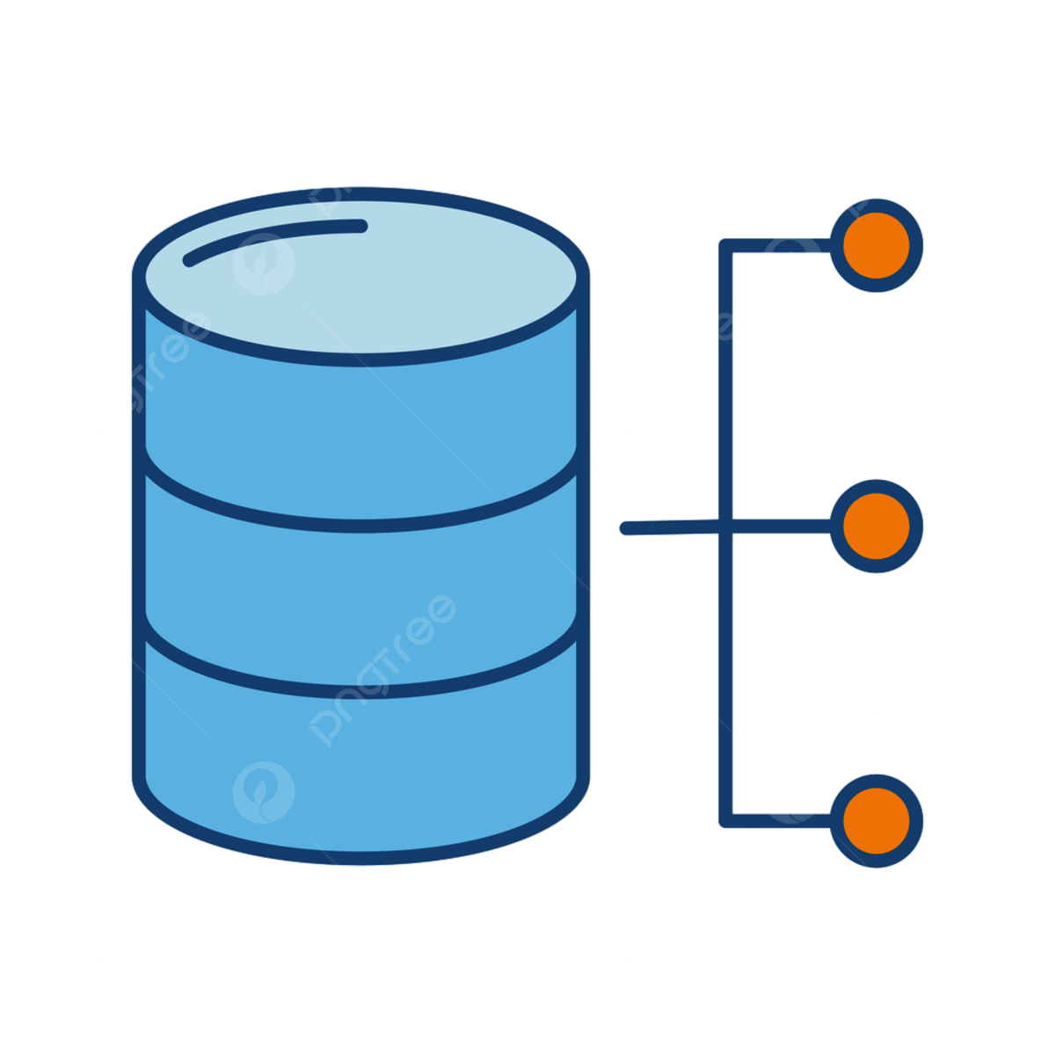
User and Admin Interaction Flow with Frontend and Backend Architecture
User
User Frontend
Backend
Backend
Admin
Food Dishes Info. Database

Slide 12



Azure Services and Resources Used
Static Web App
Web App Containers
SQL Database

Slide 13
How did we use these services for our project?

Slide 14
Azure Static Web App
Provides streamlined hosting for static content, which includes HTML, CSS, and JavaScript code for the frontend
Directly integrated with GitHub, enabling continuous deployment directly from the repository, where we uploaded our codes
Comes with built-in CI/CD

Slide 15
Azure Web App Containers
Created the images of our backend Golang code using Docker
Docker images are deployed using web app container services
By using Docker containers, we ensured that your Golang backend environment is consistent across development, testing, and production.

Slide 16
Azure SQL Database
We used two tables for our data, one was for storing the information related to users(Username, Email, and Password) and other for information related to food dishes.
Relational Data has been used
Our Golang backend in Azure Web App Containers seamlessly connected to Azure SQL Database using connection strings stored as environment variables

Slide 17
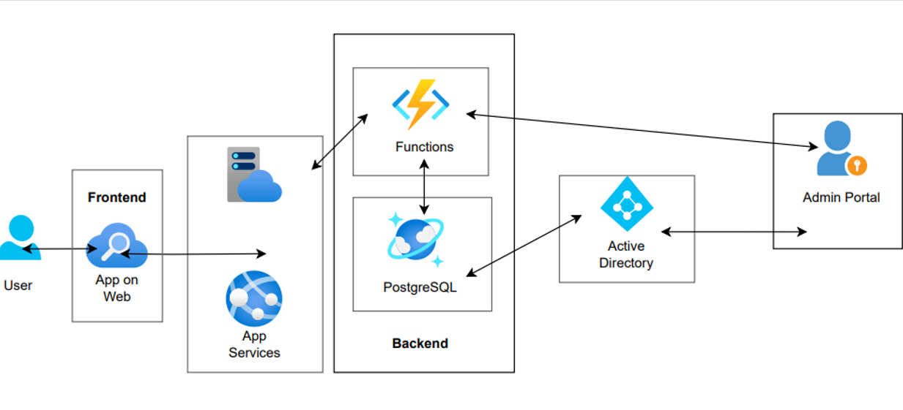
Our Previous Model

Slide 18
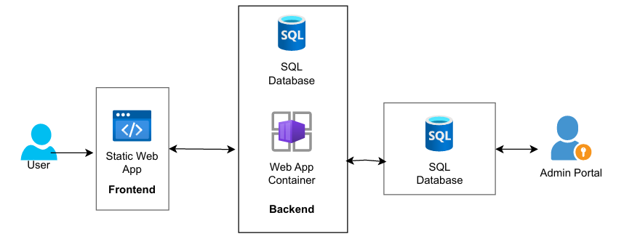
Our Current Model

Slide 19
Future Work
Build a Food Community Platform
Introduce user-driven content such as ratings and reviews for each dish
Utilize advanced analytics tools to gain insights into user interactions and demographics
Develop personalized experiences for users based on their preferences, search history, and interactions

Slide 20
Thank You

